Slide 1
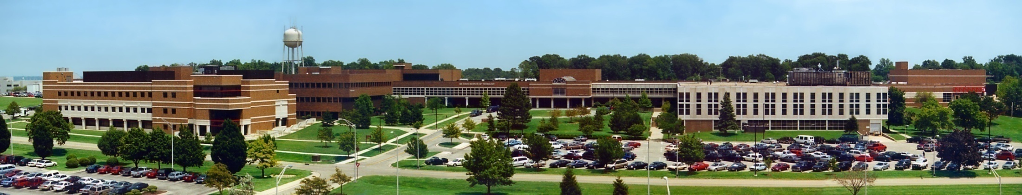
Using Soar to Build Agents for Military Simulations (Research Initiative / Project Description)
Air Force Institute of Technology
1st Lt Danny “Hocka” Lugo
Master’s Student
daniel.lugo@afit.edu
Douglas D. Hodson, PhD
Research Advisor
douglas.hodson@afit.edu
255-3636 x4719

Slide 2
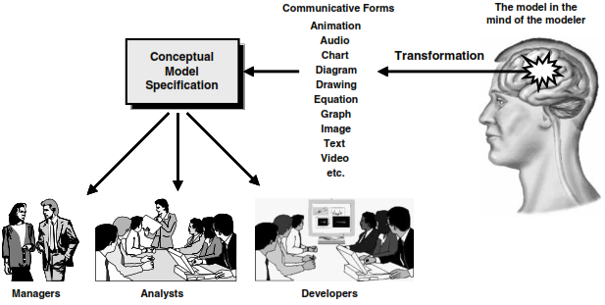
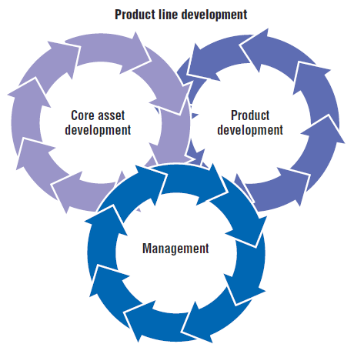



Training & Experimentation
Desire: configurable simulations and agent infrastructure to build what you need for the purpose intended
Typical software strategy employed is the development of a common simulation framework
Selected frameworks/architectures
Simulation: OpenEaagles (OE)
Cognitive: Soar
Input: conceptual model
Outputs: fidelity of models (including agent decision making capabilities)
Given a common base (software framework), lots of uniquely focused products can be generated
Open source

Slide 3
Fit for Purpose Considerations
Decision making characteristics
Analogous to model fidelity concerns
Smarter/intelligent/realistic often desirable, but not always (function of purpose)
Scalable solution is desirable (IQ: 0 → 200)
Notional examples
Training
Exhibit possibly complex yet understandable, desired behavior
Experimentation (exploratory analysis)
Exhibit behavior based on all available information, to possibly inform new CONOPs or procedures

Slide 4

SW Engineering Challenges
Some system or infrastructure in which complex ‘behavior’ can be defined
Soar
Agent/cognitive software
Some mechanism to ‘connect’ or interface disparate software systems to each other
SML
Interface
OE
Simulation software
The environment (i.e., simulation) of the system itself
Past experience and lessons learned
Lots of time spent learning about simulation (and the system representation)
Lots of time spent interconnecting ‘agent’ software to simulation software
Line between innate simulation entity capabilities and the responsibilities of what the agent controls is not always clear
Time runs out, little time spent developing a ‘good’ or useful agent to support original purpose

Slide 5


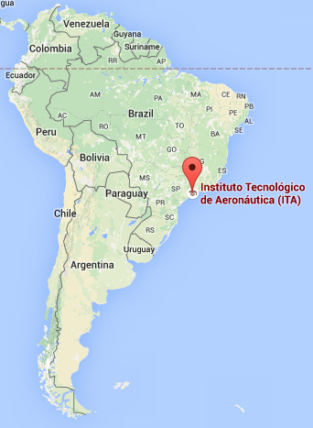
Shout-out: Initial Effort
Brazilian Federal Government (supported by Brazilian Air Force)
Technological Institute of Aeronautics
Command and Control Laboratory
Institution of higher education and advanced research with emphasis in aerospace science and technology
Extended a general purpose agent structure available in OpenEaagles
Unified Behavior Framework (UBF)
Extended Arbiter class to tap Soar, CLIPS and/or Lua scripting functionality

Slide 6
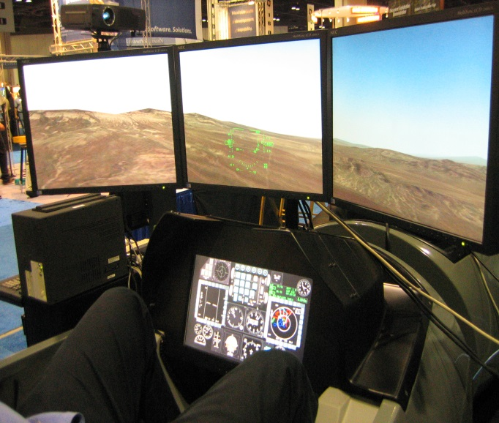
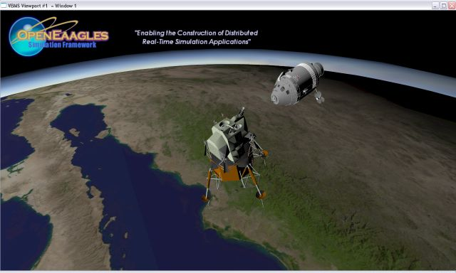
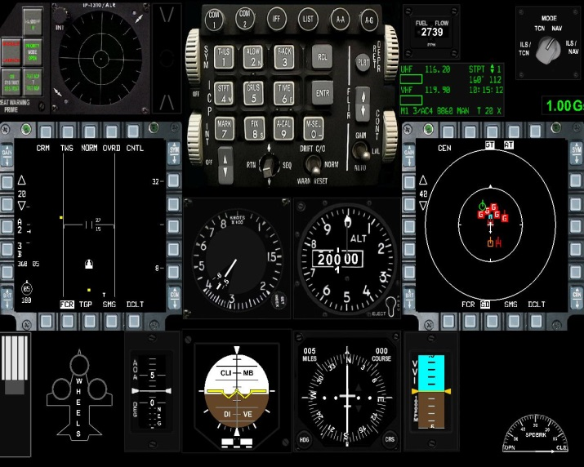
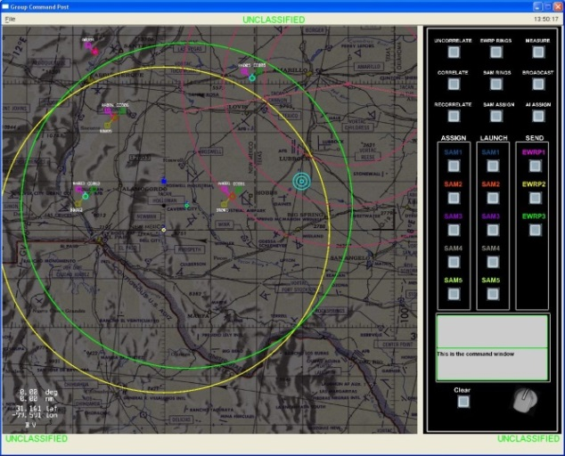
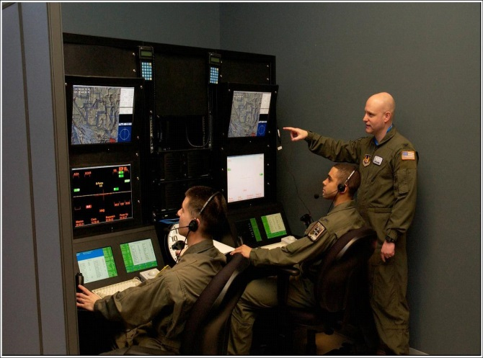
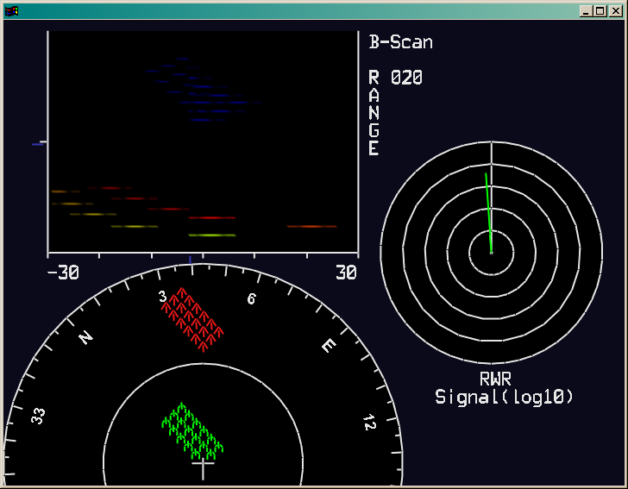
Sample of OE-based Products
Flight simulators, radar processing, UAV ground stations, C2 track mgt, even a Apollo Lunar Module

Slide 7
Motivation: Training Simulations
Modern defense systems
Aircraft
Ships
Variety of vehicles
Command and control systems
Human operators
Real-time simulations are used to train the operators
Cost effective
Less risk

Slide 8
Real-Time Large Scale Simulations
Large scale exercises utilize hundreds of constructive/automated entities
In the training environment most of these entities have humans controlling them
Manning and schedule constraints
Not enough bodies to control entities
Lack of training on the tools used to control entities

Slide 9
General Plan
Update and integrate Brazilian code with current version of OpenEaagles (v16.06)
Define scenario(s) of interest
This is mostly done – supported by other activities associated with The Technical Cooperation Program (TTCP)
Develop Soar-based agents
Evaluate
Line between innate simulation entity capabilities vs decision making responsibilities (an item of interest)
Performance/scalability (i.e., real-time decision responsiveness)
Lines of code to define behavior
Ease of agent definition (evaluation of supporting tools)

Slide 10
EOF

Slide 11
High-Level Simulation Process
Question?
(Problem Situation)
Solutions
(Understanding)
Experiment Design
(Measures, Cause/Effect, etc)
Data/Analysis
Matching of conceptual model with implementation
System Representation
(System Under Study)
Strong Reuse Component
Execution
of System Dynamics
Simulation Application
(Software – Ad Hoc)
Concrete Models
(Specific Fidelity)
Some Reuse, but often tailored
Strong Reuse Component
Simulation Framework
(Software Architecture/Infrastructure/Abstract Models)

Slide 12
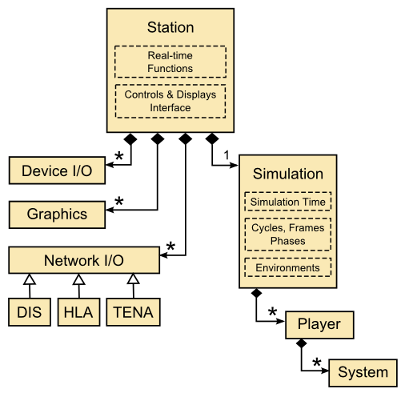
OE Simulation Design Pattern
Controller
View(s)
Model

Slide 13
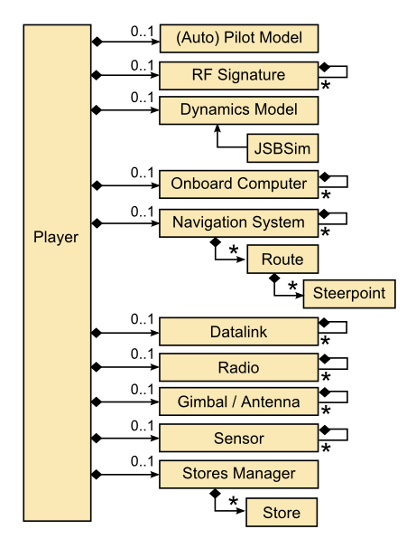
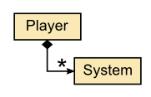
Player Pattern
Hierarchical System Model

